Slide 1
Bioinformatics for Adaptation Genomics Day 3: Inference on evolutionary signal from SNP data
Detecting signatures of natural selection
from NGS data (part 2/2)
Matteo Fumagalli
March 2nd 2016

Slide 2
Outline
Brief introduction to natural selection
Modes of selection
Inferring selection at the intra-species level
Genetic differentiation
Haplotype variation
Model-based approaches
Testing for significance
Inferring selection at the inter-species level
Detecting selection from low-depth sequencing data
Brief notes on optimal experimental design
Notes:
Broad overview on adaptation to environments

Slide 3
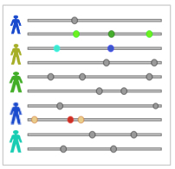
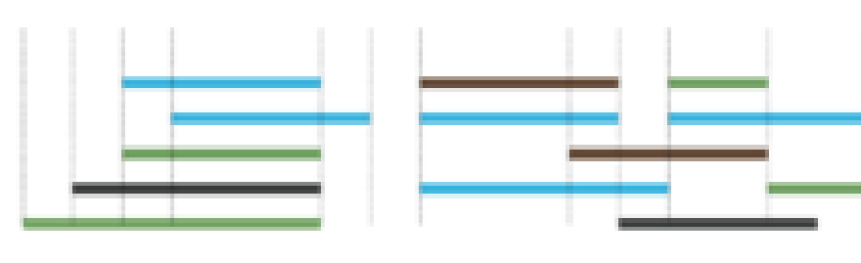
Next Generation Sequencing data processing
A,T
External information
LD information
A/T
T
Genotype
assignment
Mutation
discovery
reference genome
AAAT
short DNA fragments
Theta, Pi
Tajima’s D
F_{ST}, PBS…
Notes:
Many of the results I have shown you have been obtained by analysis of data produced by high-throughput sequencing machines.
Data sets produced by these experiments typically consist of a collection of short fragments of DNA, sequenced and mapped to a reference genome.
From the analysis of all bases covering each site and the use of external information on known mutations, genotypes are assigned at each individual, mutations are identified in the population, and finally the whole pattern of DNA variation is reconstructed.

Slide 4
Next Generation Sequencing data processing
A,T
External information
LD information
A/T
T
Genotype
assignment
Mutation
discovery
reference genome
AAAT
short DNA fragments
Theta, Pi
Tajima’s D
F_{ST}, PBS…
Notes:
What happens if you do not work on humans or easily-funded species?

Slide 5

Next Generation Sequencing data processing
in the non-model world
A,T
External information
LD information
A/T
T
Genotype
assignment
Mutation
discovery
reference genome
AAAT
short DNA fragments
Got issues?
Theta, Pi
Tajima’s D
F_{ST}, PBS…
Notes:
What happens if you do not work on humans or easily-funded species?
What are the issues

Slide 6
Next Generation Sequencing data processing
in the non-model world
A,T
External information
LD information
A/T
T
Genotype
assignment
Mutation
discovery
reference genome
AAAT
short DNA fragments
Got issues?
No reference panel information (no imputation/validation)
No reference sequence (lower mappability?)
No HWE assumption (inbred)
Hyper/Hypovariability or polyploidy or huge genome
No money (?)
…
Theta, Pi
Tajima’s D
F_{ST}, PBS…
Notes:
What happens if you do not work on humans or easily-funded species?
What are the issues

Slide 7
Next Generation Sequencing data processing
in the non-model world
A,T
External information
LD information
A/T
T
Genotype
assignment
Mutation
discovery
reference genome
AAAT
short DNA fragments
Got issues?
No reference panel information (no imputation/validation)
No reference sequence (lower mappability?)
No HWE assumption (inbred)
Hyper/Hypovariability or polyploidy or huge genome
No money (?)
Your inferences will be wrong!
Theta, Pi
Tajima’s D
F_{ST}, PBS…
Notes:
What happens if you do not work on humans or easily-funded species?
What are the issues

Slide 8

Next Generation Sequencing data processing
in the non-model world
A,T
External information
LD information
A/T
T
Genotype
assignment
Mutation
discovery
reference genome
AAAT
short DNA fragments
Got issues?
No reference panel information (no imputation/validation)
No reference sequence (lower mappability?)
No HWE assumption (inbred)
Hyper/Hypovariability or polyploidy or huge genome
No money (?)
Your inferences will be wrong!
Theta, Pi
Tajima’s D
F_{ST}, PBS…
Notes:
What happens if you do not work on humans or easily-funded species?
What are the issues

Slide 9

Next Generation Sequencing data processing
in the non-model world
A,T
External information
LD information
A/T
T
Genotype
assignment
Mutation
discovery
reference genome
AAAT
short DNA fragments
Got issues?
No reference panel information (no imputation/validation)
No reference sequence (lower mappability?)
No HWE assumption (inbred)
Hyper/Hypovariability or polyploidy or huge genome
No money (?)
Your inferences will be wrong!
Theta, Pi
Tajima’s D
F_{ST}, PBS…
There is hope!
Notes:
What happens if you do not work on humans or easily-funded species?
What are the issues

Slide 10
Next Generation Sequencing data processing
in the non-model world
A,T
External information
LD information
A/T
T
Genotype
assignment
Mutation
discovery
reference genome
AAAT
short DNA fragments
Theta, Pi
Tajima’s D
F_{ST}, PBS…
Avoiding genotype and SNP calling at all?
Notes:
What happens if you do not work on humans or easily-funded species?
What are the issues

Slide 11
Genotype likelihoods
Chrom1 272 A 24 AAAAAGGAGAGGTAAG <<<+;<<<<<<<<<<<=<;<;7<&
Base quality in Phred scale
Base
Nr of reads
Base quality
Mapping quality
…
P(D | G=AA)
P(D | G=AG)
P(D | G=GG)

Slide 12
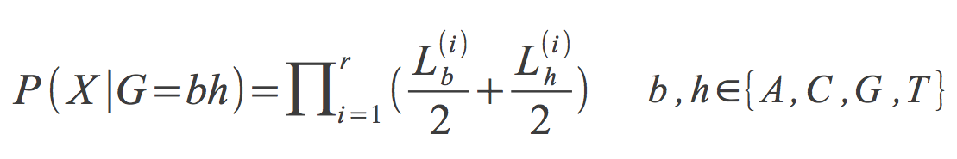
Calculating genotype likelihoods

Slide 13
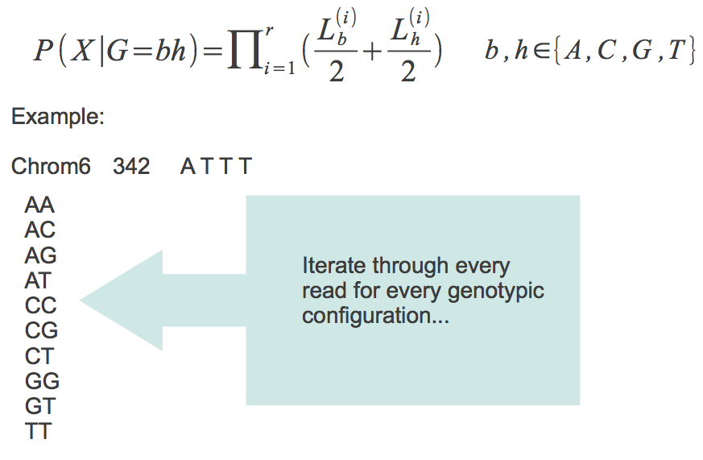
Calculating genotype likelihoods

Slide 14
Calculating genotype likelihoods

Slide 15
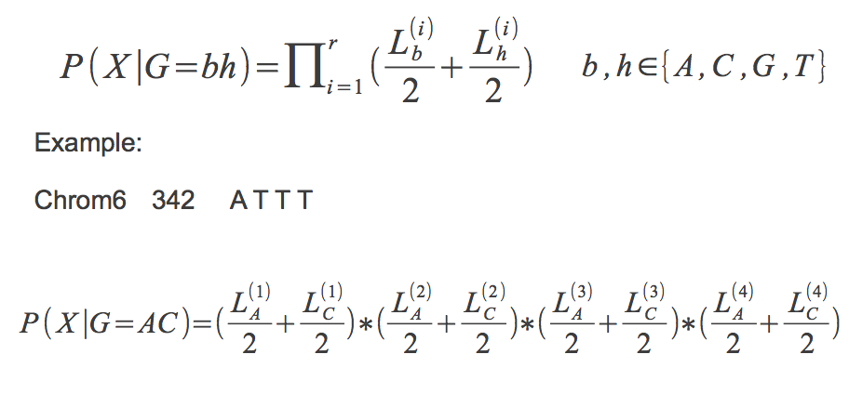
Calculating genotype likelihoods

Slide 16
Calculating genotype likelihoods

Slide 17
Calculating genotype likelihoods

Slide 18
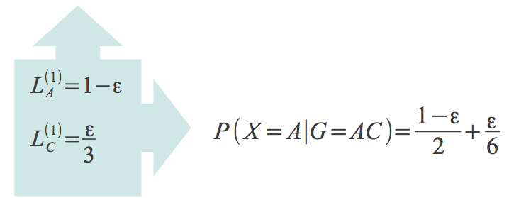
Calculating genotype likelihoods

Slide 19
Calculating genotype likelihoods

Slide 20
Calculating genotype likelihoods

Slide 21
Calculating genotype likelihoods

Slide 22
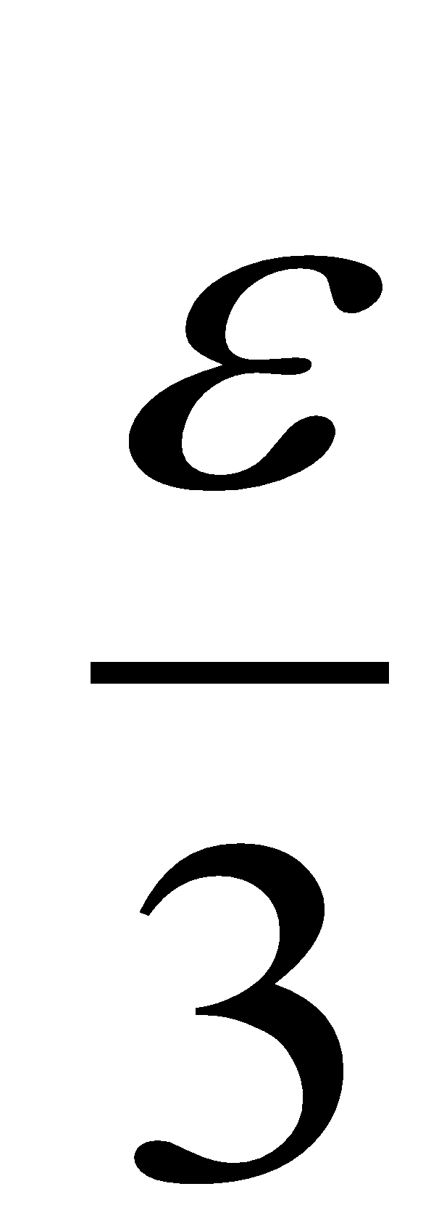
Calculating genotype likelihoods

Slide 23
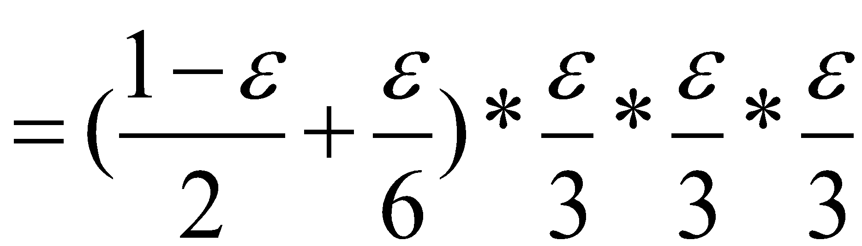
Calculating genotype likelihoods

Slide 24
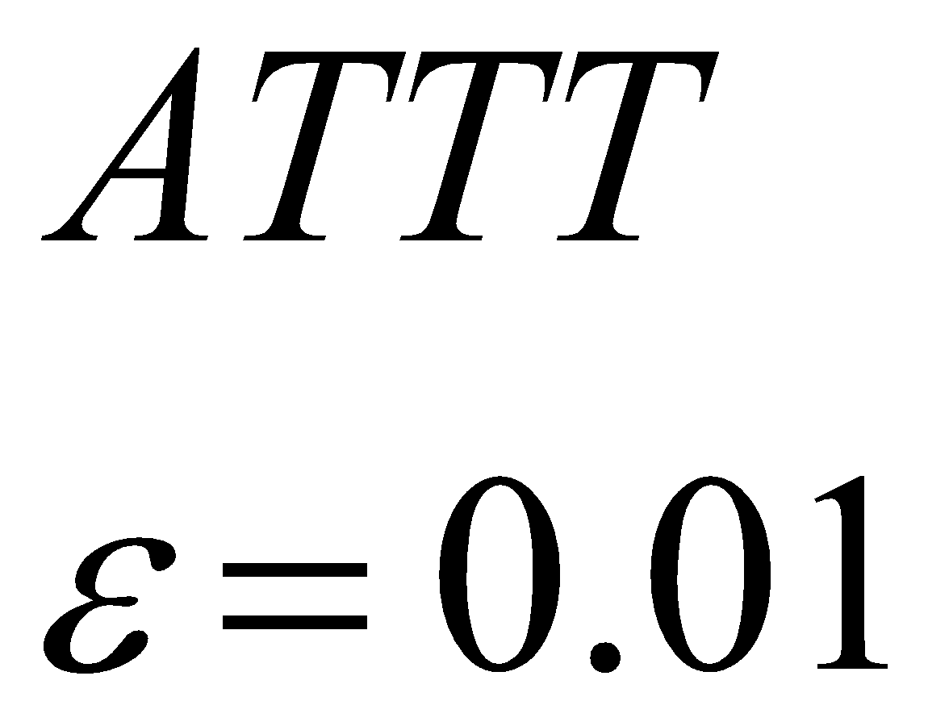
Genotype likelihoods
Genotype | Likelihood (log10)
AA | -7.44
AC | -7.74
AG | -7.74
AT | -1.22
CC | -9.91
CG | -9.91
CT | -3.38
GG | -9.91
GT | -3.38
TT | -2.49

Slide 25
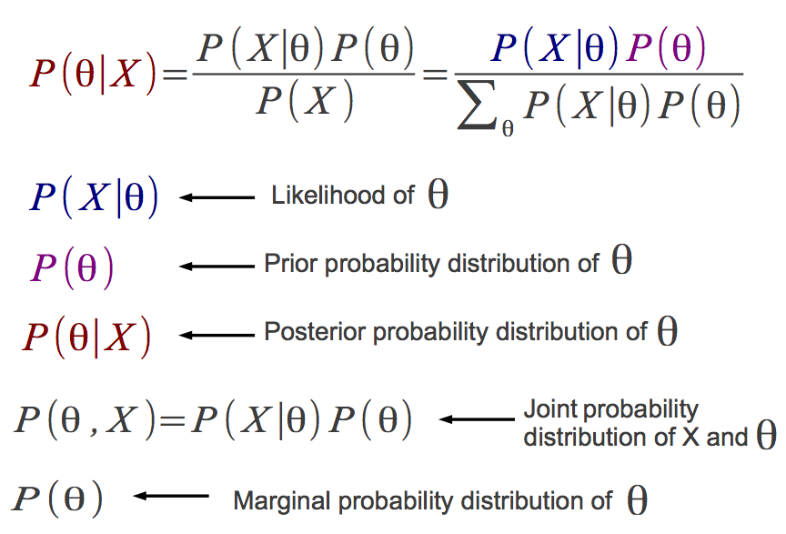
Bayesian inference

Slide 26
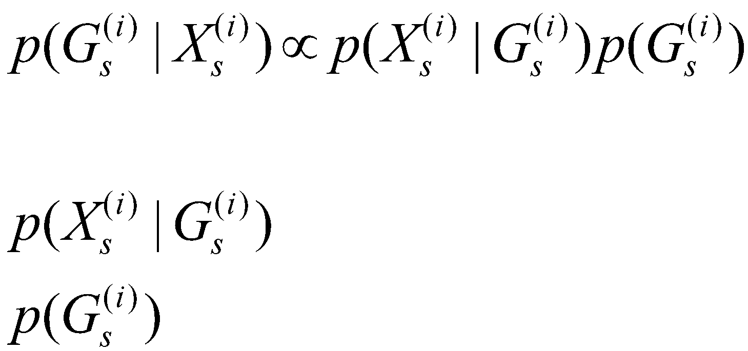
Genotype posterior probabilities
Genotype likelihood
Prior

Slide 27
Genotype posterior probabilities
Genotype | Likelihood (log10) | Prior | Posterior probability
AA | -7.44 | 0.01 | ~ 0
AC | -7.74 | 0 | 0
AG | -7.74 | 0 | 0
AT | -1.22 | 0.18 | 0.81
CC | -9.91 | 0 | 0
CG | -9.91 | 0 | 0
CT | -3.38 | 0 | 0
GG | -9.91 | 0 | 0
GT | -3.38 | 0 | 0
TT | -2.49 | 0.81 | 0.19
Better genotype caller:
(Empirical) Bayesian
P(A) = f
Where f is the allele frequency from a reference panel or estimated from the data itself
Ex: f(A)=0.10
P(AA) = f²
P(AT) = 2f(1-f)
P(TT) = (1-f)²

Slide 28
Genetic distances
A
Genotype 1 | Genotype 2 | Distance
aa | aa | 0
aa | aA | 1
aa | AA | 2
aA | aa | 1
aA | aA | 0
aA | AA | 2
… | … | …
B
C
D

Slide 29
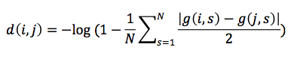
Genetic distances
A
Genotypes are {aa, aA, AA} as {0, 1 ,2}
For individuals i and j and N sites:
B
C
D
genotype of i at site s
e.g. G(i=A,s=1)=0 and G(j=B,s=1)=1 then d(i,j)=1

Slide 30
Genetic distances from known genotypes
Genotypes are {aa, aA, AA} as {0, 1 ,2}
For individuals i and j and N sites:
d(i,j) = 1*1.00 = 1.00
B
 | 0 | 1 | 2
0 | 0 | 1 | 0
1 | 0 | 0 | 0
2 | 0 | 0 | 0
A

Slide 31
Genetic distances from (un)known genotypes
Genotypes are {aa, aA, AA} as {0, 1 ,2}
For individuals i and j and N sites:
d(i,j) = 0*0.30 + 1*0.50 + 2*0.10 + 1*0.10 + … = 0.80
B
 | 0 | 1 | 2
0 | 0.30 | 0.50 | 0.10
1 | 0.10 | 0 | 0
2 | 0 | 0 | 0
A

Slide 32
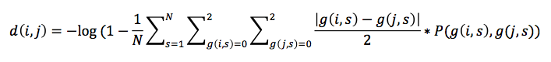
Genetic distances from unknown genotypes
A
Genotypes are {aa, aA, AA} as {0, 1 ,2}
For individuals i and j and N sites:
B
C
D
Iterate across all possible genotypes
Genotypes probability

Slide 33
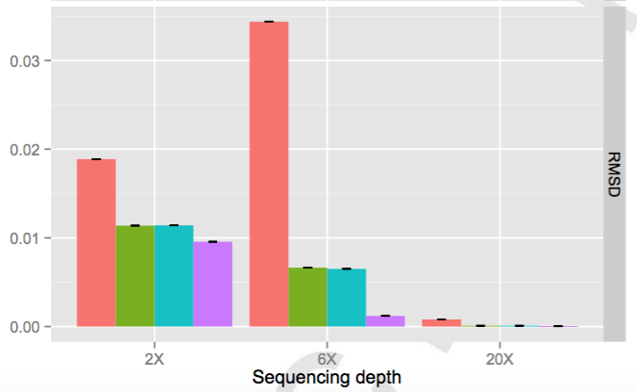
Genetic distances from unknown genotypes
“Probabilistic”
Genotype calling (no prior)
Vieira et al. BJLS 2016

Slide 34
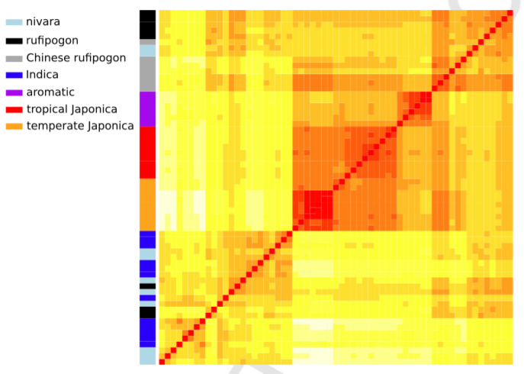
Clustering
Original data: 5.4M SNPs
Here: 5.4M SNPs at 2X
https://github.com/fgvieira/ngsDist
Vieira et al. BJLS 2016

Slide 35
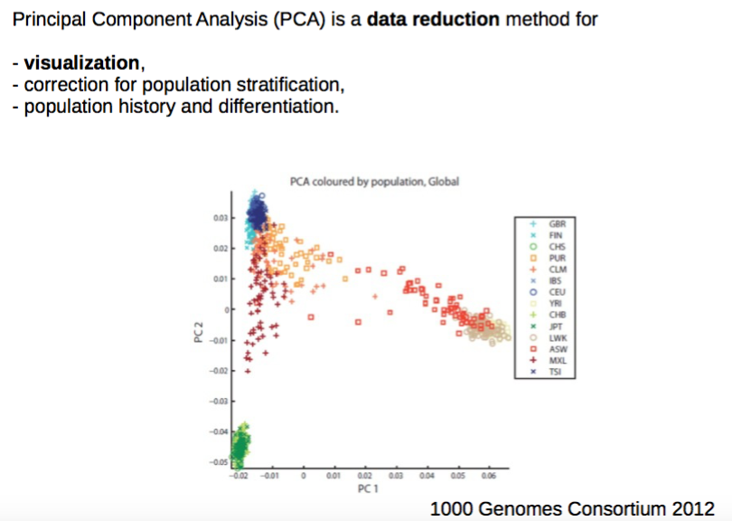
Population structure

Slide 36
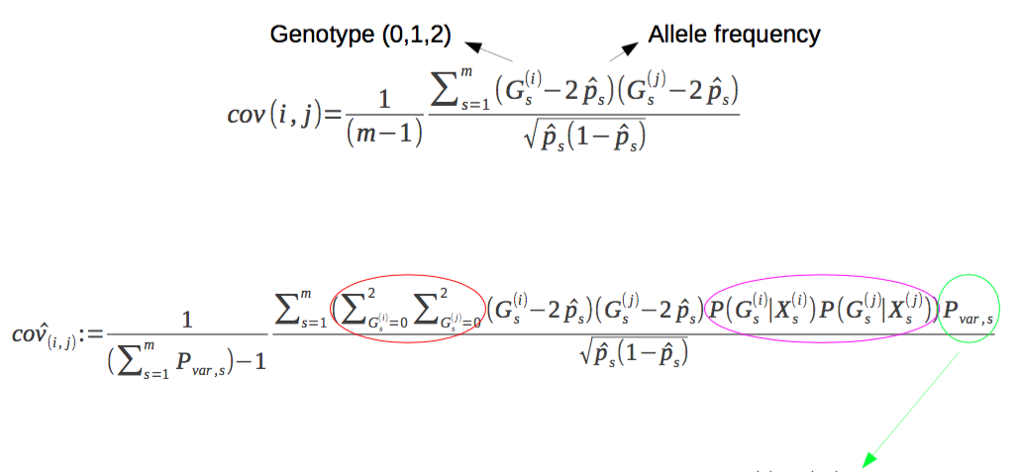
Covariance matrix
Iterate across all genotypes
Weight by their probability
Probability of the site being variable
(to avoid SNP calling)

Slide 37
Covariance matrix
Iterate across all genotypes
Weight by their probability
Probability of the site being variable
(to avoid SNP calling)

Slide 38
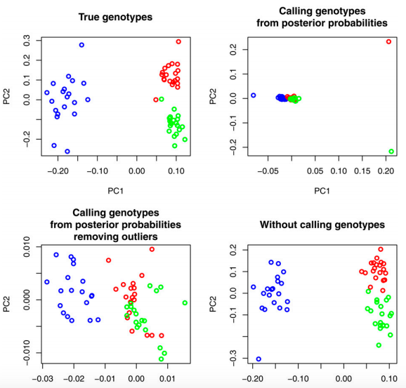
Depth=2X
https://github.com/mfumagalli/ngsTools
Fumagalli et al. Genetics 2013

Slide 39
Depth=2X
https://github.com/mfumagalli/ngsTools
Fumagalli et al. Genetics 2013

Slide 40
Sample allele frequency
With k diploid individuals, how many possible sample allele frequencies can I observe?
If unfolded, 2k+1 entries
If folded, k+1 entries
p₀ | p₁ | p₂ | p₃ | … | p_{2k}
p₀ | p₁ | p₂ | … | p_{k}

Slide 41
Sample allele frequency
With k diploid individuals, how many possible sample allele frequencies can I observe?
If unfolded, 2k+1 entries
p₀ | p₁ | p₂ | p₃ | … | p_{2k}
e.g. A is ancestral, G is derived (alternate)
AA AA AG AA AG AA AA AA AA

Slide 42
Sample allele frequency
With k diploid individuals, how many possible sample allele frequencies can I observe?
If unfolded, 2k+1 entries
p₀ | p₁ | p₂ | p₃ | … | p_{2k}
e.g. A is ancestral, G is derived (alternate)
AA AA AG AA AG AA AA AA AA

Slide 43
Sample allele frequency
With k diploid individuals, how many possible sample allele frequencies can I observe?
If unfolded, 2k+1 entries
p₀=0 | p₁=0 | p₂=1 | p₃=0 | … | p_{2k}=0
e.g. A is ancestral, G is derived (alternate)
AA AA AG AA AG AA AA AA AA

Slide 44
Sample allele frequency
With k diploid individuals, how many possible sample allele frequencies can I observe?
If unfolded, 2k+1 entries
p₀ | p₁ | p₂ | p₃ | … | p_{2k}
e.g. A is ancestral, G is derived (alternate)
If genotypes are unknown? Counting is not possible?

Slide 45
Sample allele frequency
With k diploid individuals, how many possible sample allele frequencies can I observe?
If unfolded, 2k+1 entries
p₀ | p₁ | p₂ | p₃ | … | p_{2k}
Probability of observing 1 copy
Probability of observing 0 copies
e.g. A is ancestral, G is derived (alternate)

Slide 46
Sample allele frequency
With k diploid individuals, how many possible sample allele frequencies can I observe?
If unfolded, 2k+1 entries
p₀=0.05 | p₁=0.15 | p₂=0.70 | p₃=0.10 | … | p_{2k}
Probability of observing 1 copy
Calculated from genotype likelihoods across all samples
Probability of observing 0 copies
e.g. A is ancestral, G is derived (alternate)

Slide 47
Sample allele frequency probabilities
1
Known
genotypes
0
p₀ | p₁ | p₂ | p₃ | … | p_{2k}

Slide 48
Sample allele frequency probabilities
1
Known
genotypes
0
p₀ | p₁ | p₂ | p₃ | … | p_{2k}
1
No data
0
p₀ | p₁ | p₂ | p₃ | … | p_{2k}

Slide 49
Sample allele frequency probabilities
1
Known
genotypes
0
p₀ | p₁ | p₂ | p₃ | … | p_{2k}
1
No data
0
p₀ | p₁ | p₂ | p₃ | … | p_{2k}
1
Data with
uncertainty
0
p₀ | p₁ | p₂ | p₃ | … | p_{2k}

Slide 50
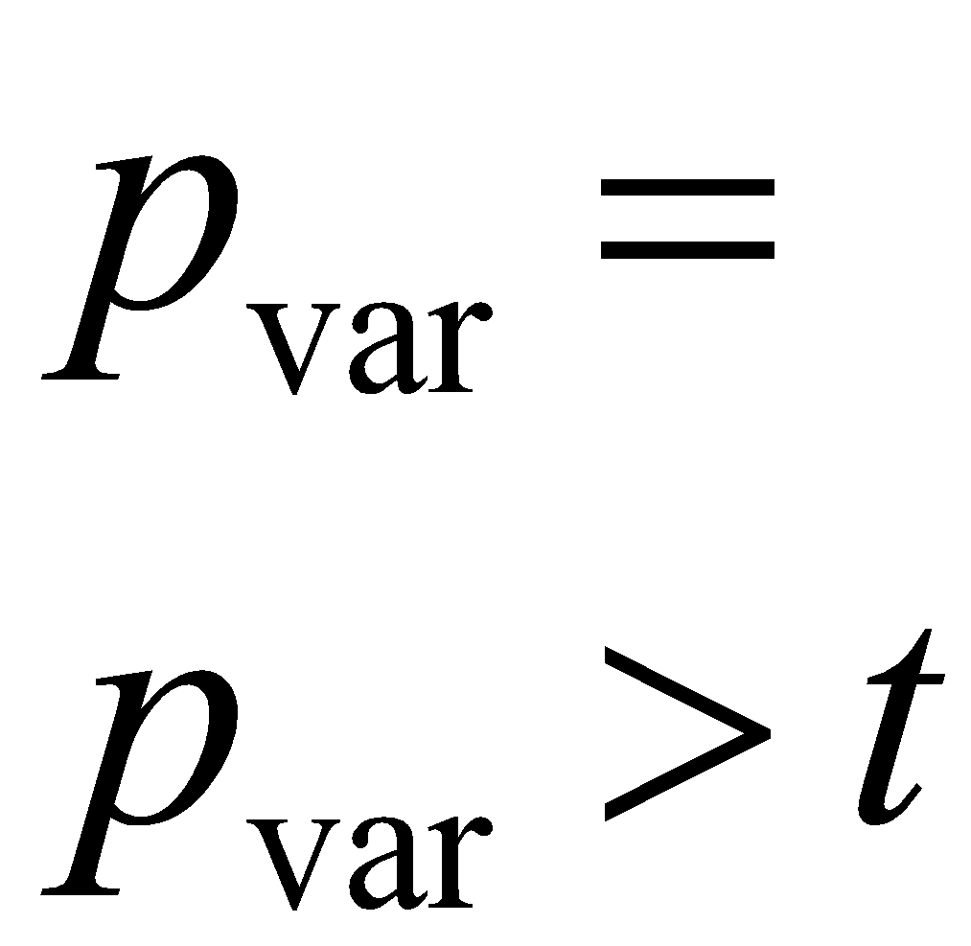
Sample allele frequency posterior probabilities
With 6 chromosomes (3 diploids)
p₀=0.10 | p₁=0.15 | p₂=0.50 | p₃=0.15 | p₄=0.05 | p₅=0.05 | p₆=0.00
SNP calling
with t being 0.95, 0.99, 0.999 and so on.
?

Slide 51
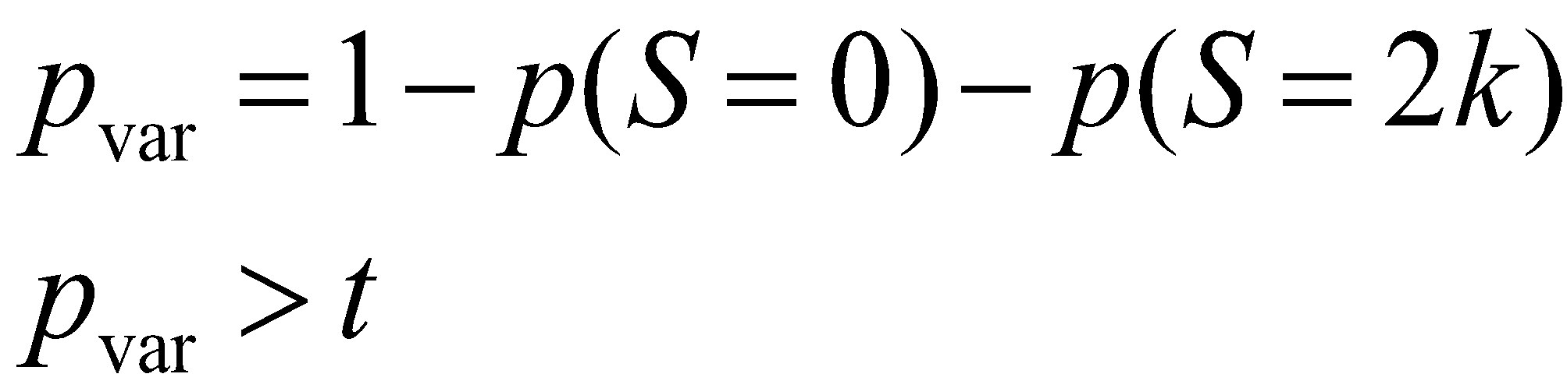
Sample allele frequency posterior probabilities
p₀=0.10 | p₁=0.15 | p₂=0.50 | p₃=0.15 | p₄=0.05 | p₅=0.05 | p₆=0.00
SNP calling
with t being 0.95, 0.99, 0.999 and so on.
= 0.90

Slide 52
Nr of segregating sites
Site 1
Site 2
Site 3
…
Site M
p(S_{m}=0) | p(S_{m}=1) | p(S_{m}=2) | p(S_{m}=3) | … | p(S_{m}=2k)
p(S_{m}=0) | p(S_{m}=1) | p(S_{m}=2) | p(S_{m}=3) | … | p(S_{m}=2k)
p(S_{m}=0) | p(S_{m}=1) | p(S_{m}=2) | p(S_{m}=3) | … | p(S_{m}=2k)
p(S_{m}=0) | p(S_{m}=1) | p(S_{m}=2) | p(S_{m}=3) | … | p(S_{m}=2k)

Slide 53
Nr of segregating sites
Site 1
Site 2
Site 3
…
Site M
p(S_{m}=0) | p(S_{m}=1) | p(S_{m}=2) | p(S_{m}=3) | … | p(S_{m}=2k)
p(S_{m}=0) | p(S_{m}=1) | p(S_{m}=2) | p(S_{m}=3) | … | p(S_{m}=2k)
p(S_{m}=0) | p(S_{m}=1) | p(S_{m}=2) | p(S_{m}=3) | … | p(S_{m}=2k)
p(S_{m}=0) | p(S_{m}=1) | p(S_{m}=2) | p(S_{m}=3) | … | p(S_{m}=2k)

Slide 54
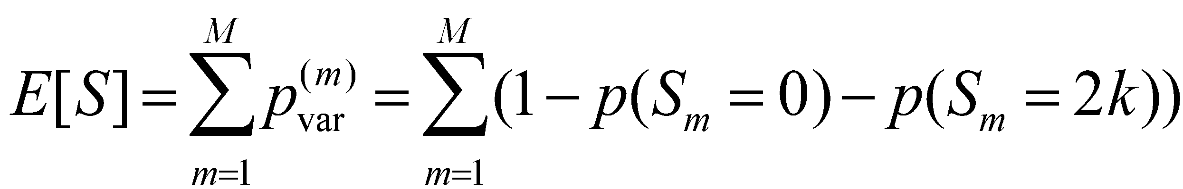
Nr of segregating sites
Site 1
Site 2
Site 3
…
Site M
p(S_{m}=0) | p(S_{m}=1) | p(S_{m}=2) | p(S_{m}=3) | … | p(S_{m}=2k)
p(S_{m}=0) | p(S_{m}=1) | p(S_{m}=2) | p(S_{m}=3) | … | p(S_{m}=2k)
p(S_{m}=0) | p(S_{m}=1) | p(S_{m}=2) | p(S_{m}=3) | … | p(S_{m}=2k)
p(S_{m}=0) | p(S_{m}=1) | p(S_{m}=2) | p(S_{m}=3) | … | p(S_{m}=2k)

Slide 55
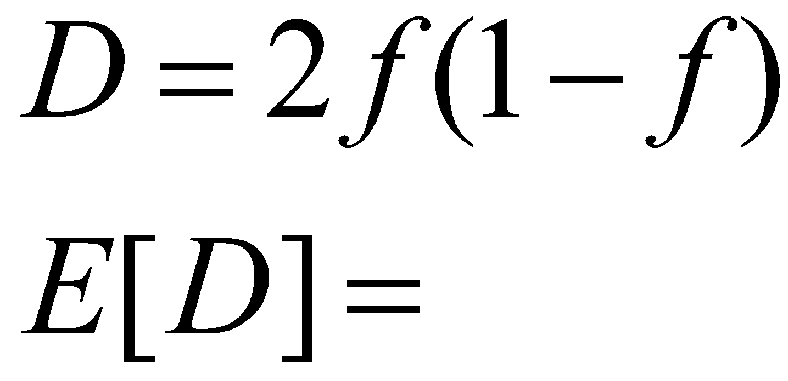
Nucleotide diversity
Site 1
Site 2
Site 3
…
Site M
p(S_{m}=0) | p(S_{m}=1) | p(S_{m}=2) | p(S_{m}=3) | … | p(S_{m}=2k)
p(S_{m}=0) | p(S_{m}=1) | p(S_{m}=2) | p(S_{m}=3) | … | p(S_{m}=2k)
p(S_{m}=0) | p(S_{m}=1) | p(S_{m}=2) | p(S_{m}=3) | … | p(S_{m}=2k)
p(S_{m}=0) | p(S_{m}=1) | p(S_{m}=2) | p(S_{m}=3) | … | p(S_{m}=2k)

Slide 56
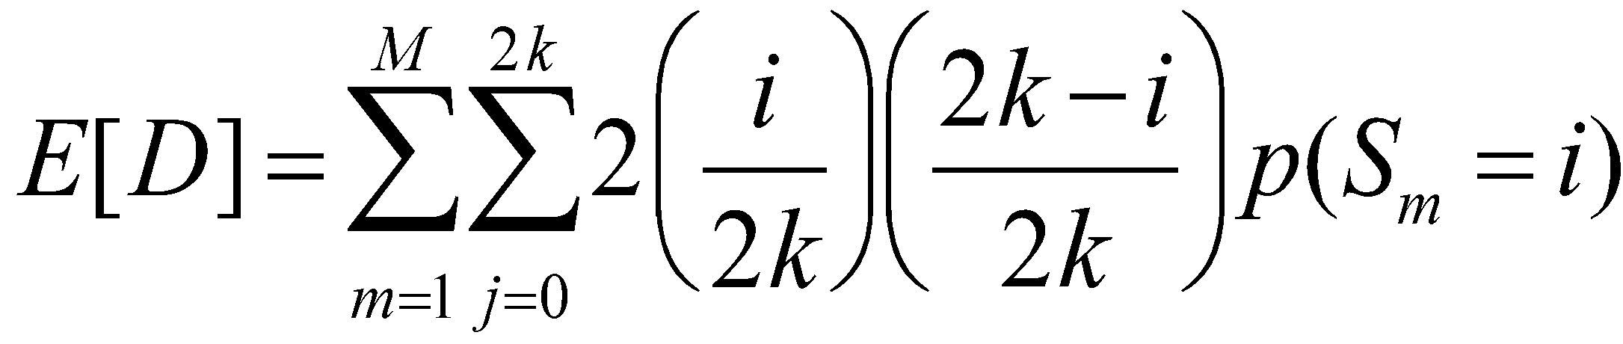
Nucleotide diversity
Site 1
Site 2
Site 3
…
Site M
p(S_{m}=0) | p(S_{m}=1) | p(S_{m}=2) | p(S_{m}=3) | … | p(S_{m}=2k)
p(S_{m}=0) | p(S_{m}=1) | p(S_{m}=2) | p(S_{m}=3) | … | p(S_{m}=2k)
p(S_{m}=0) | p(S_{m}=1) | p(S_{m}=2) | p(S_{m}=3) | … | p(S_{m}=2k)
p(S_{m}=0) | p(S_{m}=1) | p(S_{m}=2) | p(S_{m}=3) | … | p(S_{m}=2k)

Slide 57
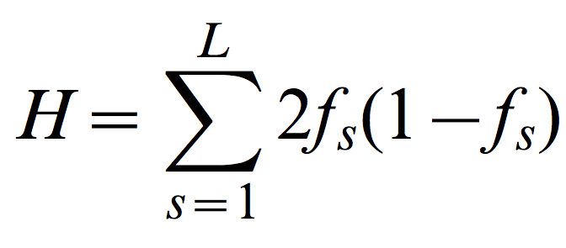
Calculating summary statistics from unknown genotypes
Allele frequency
Notes:
Very briefly, imagine that we want to calculate the expected heterozygosity H which is simply a function of the allele frequency. However the low-coverage nature of our data set doesn’t allow us to assign individual genotypes.

Slide 58
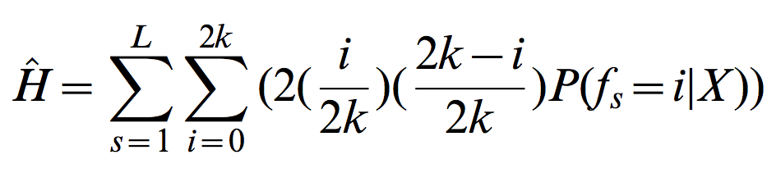
Calculating summary statistics from unknown genotypes
Allele frequency
Iterate across all possible sample allele frequencies
Weight by their probability
Notes:
In our framework, summary statistics are simply computed as expectations from the distribution of genotypes or allele frequencies posterior probabilities, which are calculates from the reads data.
These methods have been implemented in a software…

Slide 59
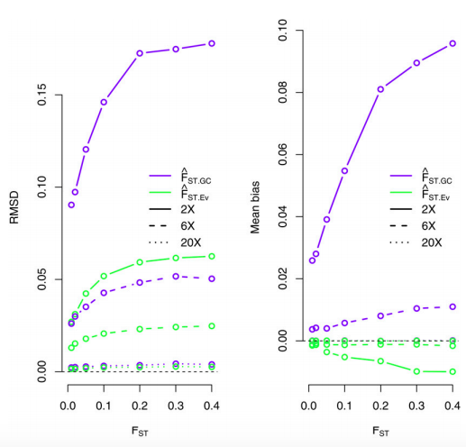
Accuracy of F_{ST} estimation
https://github.com/mfumagalli/ngsTools
Fumagalli et al. Genetics 2013

Slide 60
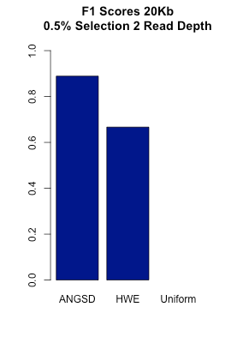
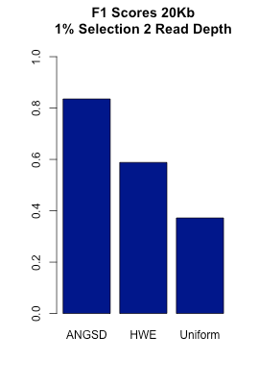
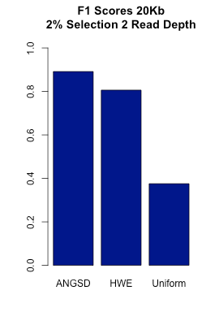
Detecting selection from low-depth sequencing data
Genotype calling
Probabilistic estimation of population differentiation outperforms methods based on genotype calling at low depth
Ousby et al. in preparation

Slide 61
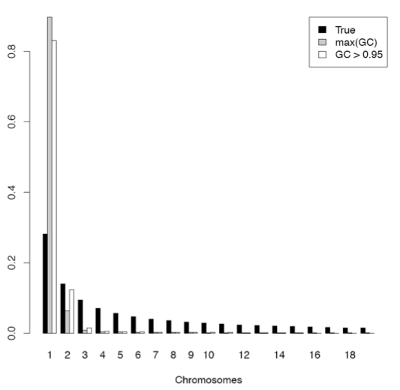
Effect of errors on SFS
5X
From called genotypes
Slide by R. Nielsen

Slide 62
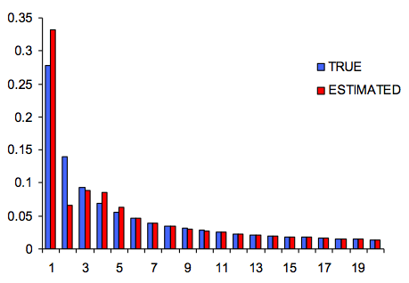
Effect of errors on SFS
Using an ad hoc fixed cutoff for SNP calling…
can never produce unbiased estimates.
Slide by R. Nielsen

Slide 63
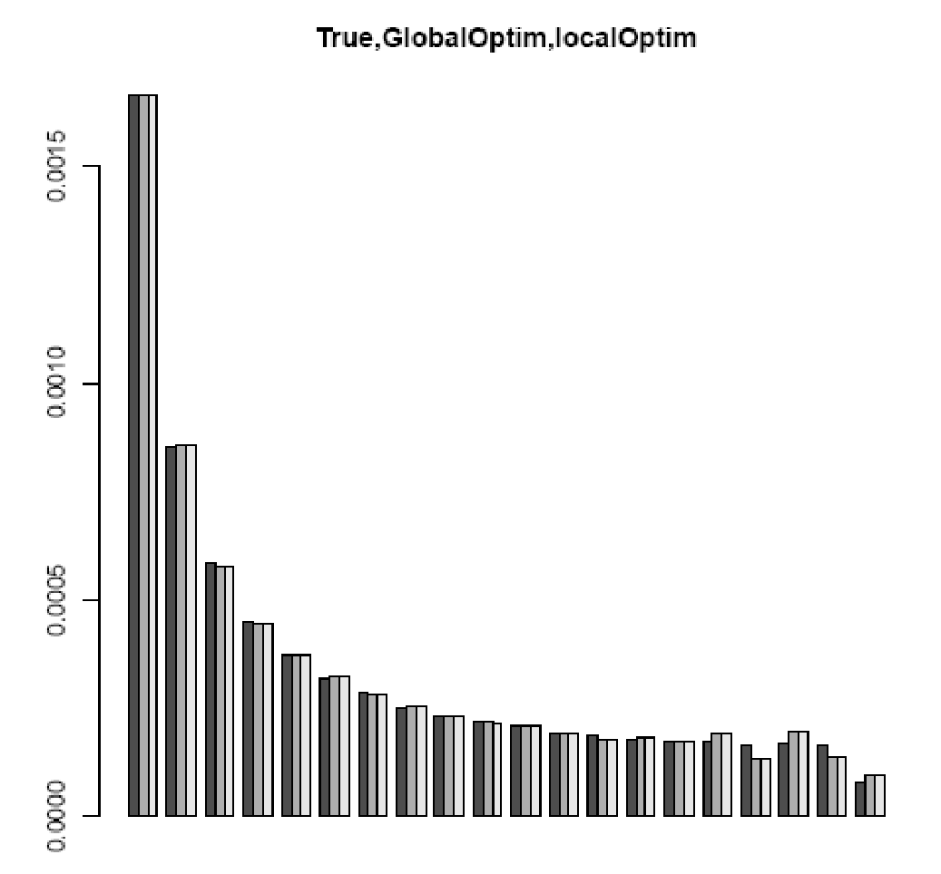
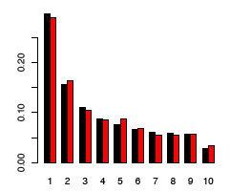
ML estimation of the SFS
Simulated 30Mb
Error rate of 0.3%
Mean depth of 5X
Mean depth of 1X:
TRUE
MLE
MLE, 6 regions combined
Slide by R. Nielsen

Slide 64
Next Generation Sequencing data processing
in the non-model world
A,T
External information
LD information
A/T
T
Genotype
assignment
Mutation
discovery
reference genome
AAAT
short DNA fragments
ERROR DECREASE
COST DECREASE
FLEXIBILITY
Theta, Pi
Tajima’s D
F_{ST}, PBS…
Avoiding genotype and SNP calling at all?
Notes:
What happens if you do not work on humans or easily-funded species?
What are the issues

Slide 65
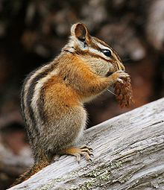
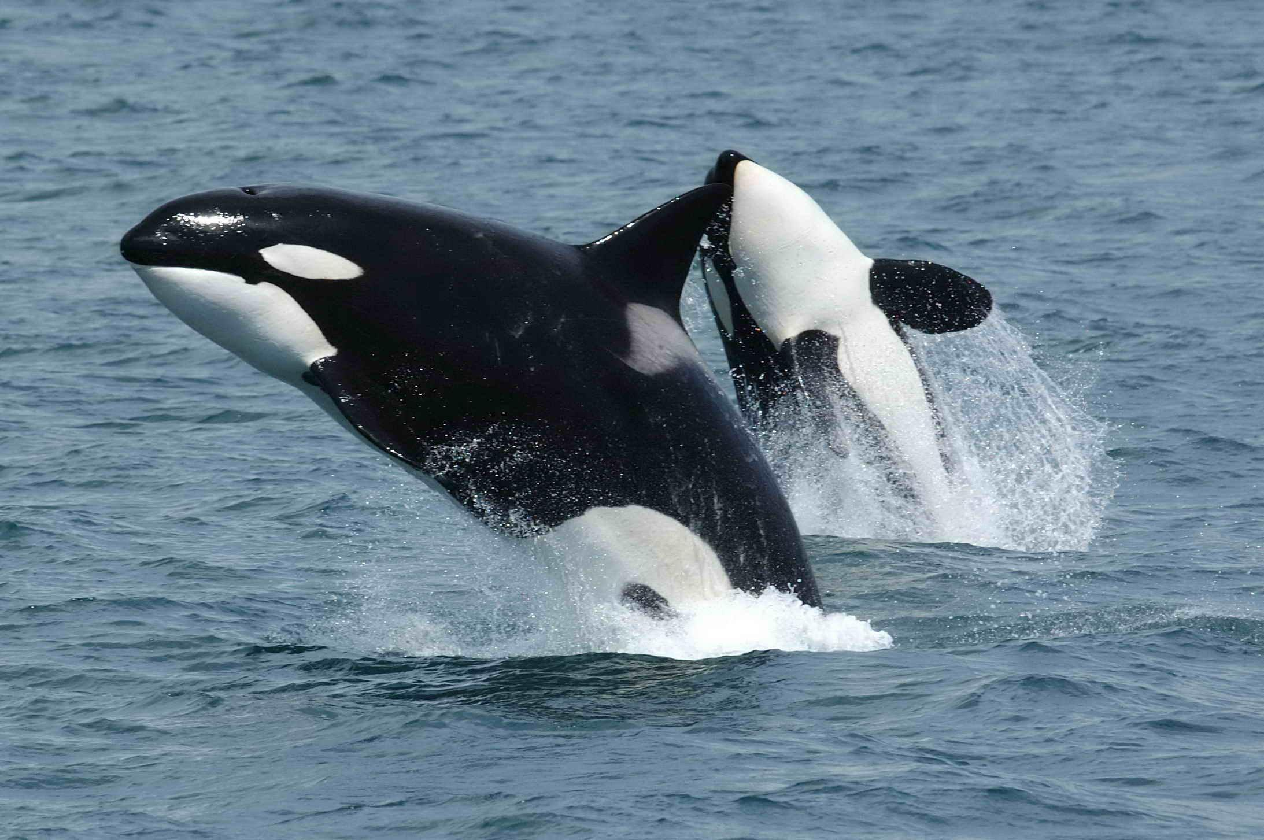
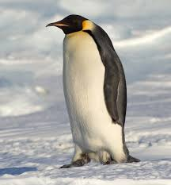
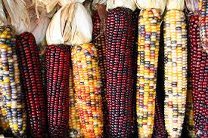
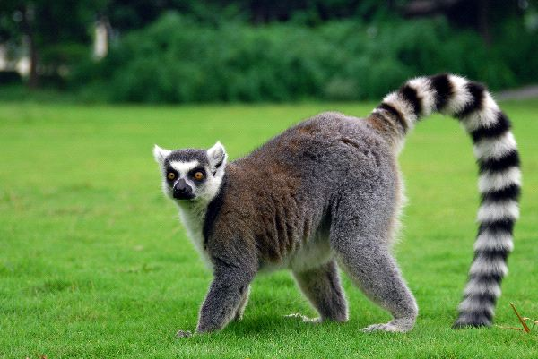
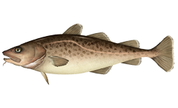
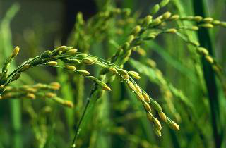
Applications
Model and non-model species
Plants
Ancient genomes
…
…
Notes:
…that is now becoming widely used in population genomic studies of several organisms especially non-model organisms.
I would like now to highlight some of the research directions I would like to pursue in the near future.

Slide 66
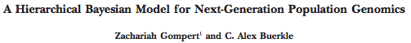
Software
Such advanced methods have been implemented in several software and utilities, such as:
ANGSD (http://popgen.dk/ANGSD)
ngsTools (https://github.com/mfumagalli/ngsTools)
http://jnpopgen.org/software/
which we will explore during the practical session.
Genetics, 2011

Slide 67

Experimental design
You discovered a new species!

Slide 68
Experimental design
You have access to many samples!

Slide 69
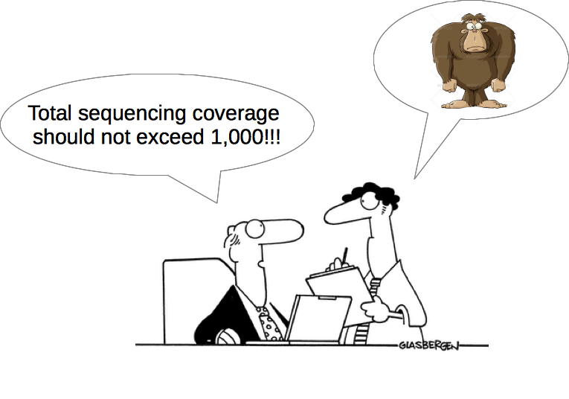
Experimental design
...

Slide 70

Experimental design
...

Slide 71

Experimental design

Slide 72
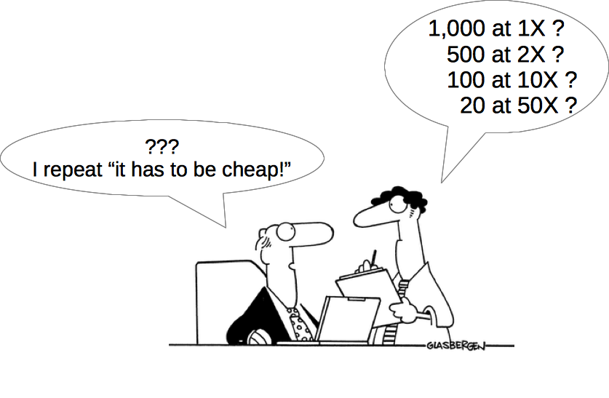
Experimental design

Slide 73

Experimental design
At a fixed budget…
Few samples
at higher quality
More samples
at lower quality

Slide 74
Simulations design
The sequencing strategy can easily be modeled in terms of the number of sequenced samples and the per-sample sequencing depth.
Sample size | Per-sample depth
1,000 | 1X
500 | 2X
100 | 10X
20 | 50X
total depth is 1,000X
Fumagalli. PLoS One 2012

Slide 75
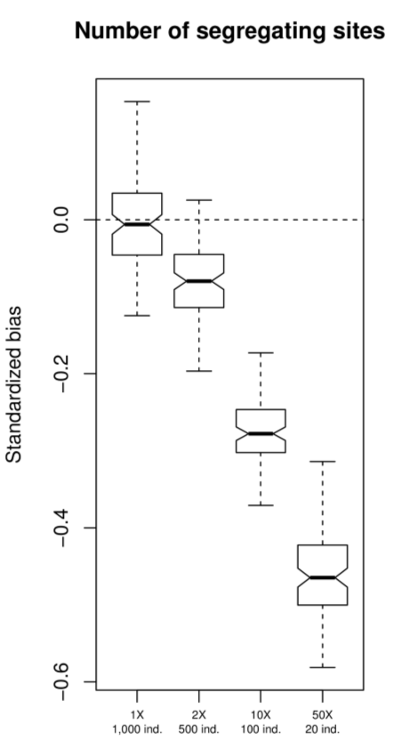
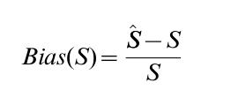
Over-estimating
Under-estimating
Compared against the
whole population!

Slide 76
Compared against the
whole population!

Slide 77
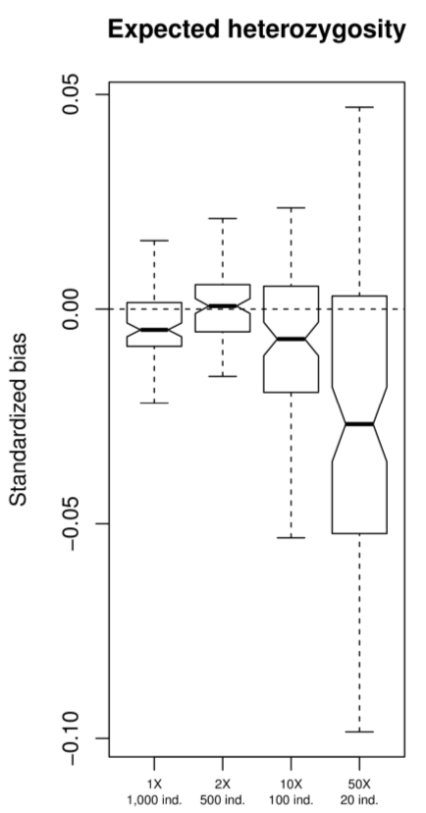
Compared against the
whole population!

Slide 78
Compared against the
whole population!

Slide 79
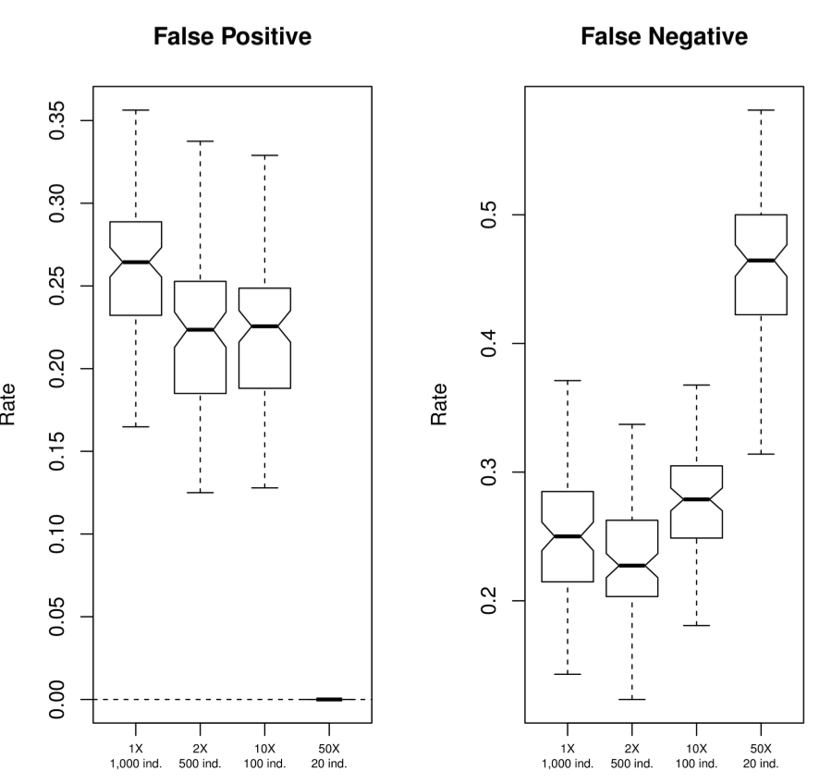
SNP calling

Slide 80
SNP calling

Slide 81
SNP calling

Slide 82
Experimental design
At a fixed budget…
For detecting selection:
Sample allele frequencies will be a better representation of population variation
Few samples
at higher quality
More samples
at lower quality

Slide 83

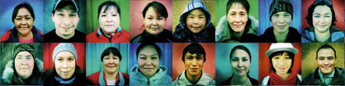
Greenlandic Inuit
greenlandtoday.com

Slide 84
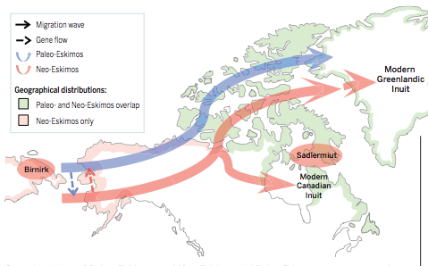
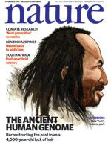
Greenlanders’ history
Independence I (N, 2500 BC - 1 AD ?)
Saqqaq (W,S, ...)
Dorset (N, 800 BC - 1 AD ?)
Late Dorset (N, 700 AD - 1300)
Thule/Inuit (N, 1100 AD; W,S 1300)
Norse Vikings (S, 985 - 1450 AD)
Danish (1720-1979)
Rasmussen et al. Nature 2010
Raghavan et al. Science 2014

Slide 85


Genome-wide scan for positive selection in the Inuit genomes
Understand the genetic basis of adaptation to:
cold climate high-fat diet
A traditional Inuit diet is rich in fat (more than 50%) with high content of long chain ω-3 polyunsaturated fatty acids (PUFAs).
Notes:
fish and marine mammals (seals), supplemented with meat from land mammals, bird eggs, berries, and a limited amount of plants and seaweed.
high content of long chain ω-3 polyunsaturated fatty acids (PUFAs).
A traditional Inuit diet was made of more than 50% fat

Slide 86

Samples and genetic data
More than 4,500 Greenlandic individuals (roughly 10% of adult population)
Almost 200,000 SNPs genotyped
Exome sequencing data on a subset of individuals

Slide 87
Test for positive selection
Neutral evolution
Positive selection
Greenlanders
Greenlanders
Chinese
T₁
T₂
T₁
Chinese
T₂
T₃
T₃
Europeans
Europeans
Population Branch Statistic (PBS) ≈ T₁₂ + T₁₃ - T₂₃
Yi et al. Science 2010

Slide 88

Positive selection scan
SNPs showing great genetic differentiation compared to Chinese and Europeans.

Slide 89


Phenotypic associations
Weight (P = 1.1×10⁻⁶, e.s.=-2.4 kg) Height (P = 4.55 × 10⁻⁷ , e.s.=-1.2 cm)
Replicated in European cohorts
(previously missed by GWASs)
Association with red blood cell lipid composition suggests an effect on growth hormones.
Fumagalli*, Moltke* et al. Science, 2015
Notes:
But the beauty of this data set is that we have also access to recorded phenotypes and by performing targeted association test we found that the allele under selection are strongly associated with several anthropometric and metabolic traits, with the association with height replicated in a European cohort.
Notably, the association in Europeans was completely missed by previous GWASs because of the low allele frequency in Europeans.

Slide 90


Demographic model
Estimate the divergence process of Inuit by fitting the joint Site Frequency Spectrum (SFS) with East Asians
Time = 23 kya

Slide 91

Positive Selection
Estimate the time and strength (s=3%) of selection using an Approximate Bayesian Computation (ABC) technique.
Start of selection
Time = 20 kya
Posterior
probability
Years before present

Slide 92

Positive selection in Native Americans in FADS genes?
Europeans
East Asians
Peruvians
Low-depth (2X)
Admixed population
Whole-genome sequencing data from 1000 Genomes Project
Raghavan et al. 2015 Science
https://github.com/mfumagalli/Weggis

Slide 93

Thanks
Practical at: https://github.com/mfumagalli/Weggis

